Slide 1
Telecommunications, the Internet, and Wireless Technology
VIDEO CASES:
  Case 1: Telepresence Moves Out of the Boardrooom and Into the Field
  World’s Most Collaborative Company??
  Case 2: Unified Communications Systems: Virtual Collaboration with Lotus Sametime
Notes:
There are two video cases and three instructional videos available for this chapter.

Slide 2
Learning Objectives
Identify the principal components of telecommunications networks and key networking technologies.
Identify the different types of networks.
Describe how the Internet and Internet technology work and how they support communication and e-business.
Describe the principal technologies and standards for wireless networking, communication, and Internet access.
Describe radio frequency identification and wireless sensor networks and identify why these are valuable business technologies.
Notes:
This chapter discusses the principle technologies used in networking and the Internet. Ask students what the difference is between a network and the Internet. Why is networking so important to modern organizations? How many students have wireless networks at home? How many have a smartphone that uses a 3G or 4G network? What’s the difference between a 4G network and Wi-Fi? How many students have seen an RFID tag?

Slide 3
Telecommunications and Networking in Today’s Business World
Networking and Communication Trends
  Convergence:
    Telephone networks and computer networks converging into single digital network using Internet standards
  Broadband:
    More than 68% U.S. Internet users have broadband access
  Broadband wireless:
    Voice, data communication are increasingly taking place over broadband wireless platforms
Notes:
This slide discusses recent developments in networking technologies. Ask students to give an example of convergence. How fast is broadband today? How many of your students have broadband? Note that in 2000, typical Internet access speeds were 56 kbps over a telephone line, costing 25 cents per kilobit, whereas today broadband speeds are 1 to 5 mbps, costing 1 cent per kilobit (or 10 cents per gigabit). Are students aware of how fast their Internet connections are at home, school, or work? Ask students if they know the speed of their cell phone’s Internet connection. The point here is to try and raise awareness of telecommunications systems among students.

Slide 4
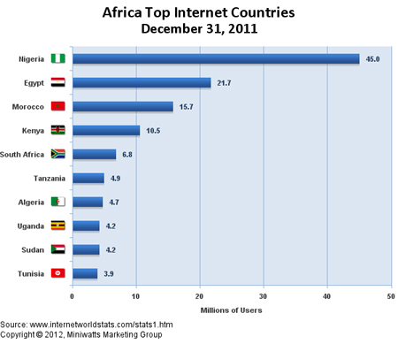
Telecommunications and Networking in Today’s Business World
Notes:
This slide discusses recent developments in networking technologies. Ask students to give an example of convergence. How fast is broadband today? How many of your students have broadband? Note that in 2000, typical Internet access speeds were 56 kbps over a telephone line, costing 25 cents per kilobit, whereas today broadband speeds are 1 to 5 mbps, costing 1 cent per kilobit (or 10 cents per gigabit). Are students aware of how fast their Internet connections are at home, school, or work? Ask students if they know the speed of their cell phone’s Internet connection. The point here is to try and raise awareness of telecommunications systems among students.

Slide 5
Telecommunications and Networking in Today’s Business World
Number of Internet users in Kenya stood at 16.2 million by December 31st ‘12, an 11.6 percent growth from the 14.5 million users recorded at the end of September ‘12.
Internet penetration went up by 4.3 percent to 41.1 percent in the last quarter of ‘12 (the second quarter of the 2012/2013 financial year).
Number of Internet subscribers increased by 75.1 percent in the quarter compared to same period in 2011.
Source: CCK April 18th ‘13
Notes:
This slide describes what a network is along with the components that you will find in a simple network (illustrated on the next slide.) Ask students to describe the function of an NIC. What is a connection medium? Ask students to describe the purpose of a hub, switch, and router.

Slide 6
Telecommunications and Networking in Today’s Business World
Mobile data/Internet continued to dominate the market contributing 99% of the total internet/data subscriptions in the country.
Number of broadband subscribers declined to 1,002,701 from 1,006,071 posted during the previous period, mainly due to a reduction in the number of fixed terrestrial broadband.
International Internet used bandwidth rose to 328,641 Megabytes per second (Mbps) from 278,329 Mbps posted during the previous period, representing an increase of 18.1 percent.
Source: CCK April 18th ‘13
Notes:
This slide describes what a network is along with the components that you will find in a simple network (illustrated on the next slide.) Ask students to describe the function of an NIC. What is a connection medium? Ask students to describe the purpose of a hub, switch, and router.

Slide 7
Telecommunications and Networking in Today’s Business World
Total number of mobile subscribers in Kenya rose to 30.7 million, representing a marginal growth of 1.0 percent from the previous quarter – Mature/Saturated Market?
Pre-paid subscribers still dominate the mobile sub-sector contributing 99 percent of the total number of subscribers.
Mobile penetration increased to 78% during the same period up from 77.2% during the first quarter.
Number of letters sent locally declined by 2.0% to reach 17.3 million down from 17.7 million letters sent during previous period – 11.8% decline compared to same period a year ago.
Source: CCK April 18th ‘13
Notes:
This slide describes what a network is along with the components that you will find in a simple network (illustrated on the next slide.) Ask students to describe the function of an NIC. What is a connection medium? Ask students to describe the purpose of a hub, switch, and router.

Slide 8
Telecommunications and Networking in Today’s Business World
Computer network
  Two or more connected computers
  Major components in simple network
    Client and server computers
    Network interfaces (NICs)
    Connection medium
    Network operating system
    Hubs, switches, routers
  Software-defined networking (SDN)
    Functions of switches and routers managed by central program
Notes:
This slide describes what a network is along with the components that you will find in a simple network (illustrated on the next slide.) Ask students to describe the function of an NIC. What is a connection medium? Ask students to describe the purpose of a hub, switch, and router.

Slide 9
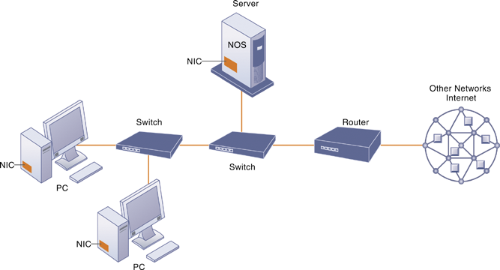
Components of a Simple Computer Network
FIGURE 1
Illustrated here is a very simple computer network, consisting of computers, a network operating system residing on a dedicated server computer, cabling (wiring) connecting the devices, network interface cards (NIC), switches, and a router.
Notes:
This graphic illustrates the components of a simple network. Although the NOS is shown as part of the server, note that, depending on the type of software, an NOS may also be designed to reside on client computers (these are called peer-to-peer networks). Do some students have a home computer network? Ask them to describe the elements of the network.

Slide 10
Telecommunications and Networking in Today’s Business World
Networks in large companies
  Hundreds of local area networks (LANs) linked to firmwide corporate network
  Various powerful servers
    Web site
    Corporate intranet, extranet
    Backend systems
  Mobile wireless LANs (Wi-Fi networks)
  Videoconferencing system
  Telephone network
  Wireless cell phones
Notes:
This slide looks at the additional components one might expect to find in the network of a large company that has many locations and thousands of employees (illustrated on the next slide). Ask students what is meant by “backend systems.” Note that many firms are dispensing with traditional landline telephone networks and using Internet telephones that run on existing internal data networks and the Internet.

Slide 11
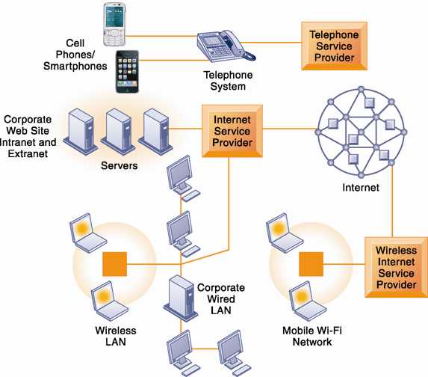
Corporate Network Infrastructure
Today’s corporate network infrastructure is a collection of many different networks from the public switched telephone network, to the Internet, to corporate local area networks linking workgroups, departments, or office floors.
FIGURE 2
Notes:
This graphic illustrates the components of a large company’s network. Note the difference between the wireless LAN, which allows wireless access within the office, and the mobile Wi-Fi network, which allows Internet access to employees outside of offices. The advantage of telephone-based wireless systems is that they do not require a Wi-Fi hotspot to work, and in fact can connect users to the entire globe through their telephone networks. Cable networks—major competitors of telephone company Internet providers—have recently developed a mobile option. Optimum Cable (Comcast) has installed neighborhood Wi-Fi hot spots, allowing cable subscribers wireless access to the Internet.

Slide 12
Telecommunications and Networking in Today’s Business World
Key digital networking technologies
  Client/server computing
    Distributed computing model
    Clients linked through network controlled by network server computer
    Server sets rules of communication for network and provides every client with an address so others can find it on the network
    Has largely replaced centralized mainframe computing
    The Internet: largest implementation of client/server computing
Notes:
This slide and following two slides look at the main technologies in use today for networks: client/server computing, packet switching, and TCP/IP. Ask students what advantages client/server computing has over centralized mainframe computing.

Slide 13
Telecommunications and Networking in Today’s Business World
Key digital networking technologies (cont.)
  Packet switching
    Method of slicing digital messages into parcels (packets) e.g. VoIP, sending packets along different communication paths as they become available, and then reassembling packets at destination
    Previous circuit-switched networks e.g. PSTN required assembly of complete point-to-point circuit
    Packet switching more efficient use of network’s communications capacity.
Notes:
This slide continues the discussion of the three main networking technologies today, looking at the second, packet switching. Note that circuit-switched networks were expensive and wasted available communications capacity—the circuit had to be maintained whether data was being sent or not. It is also important to note that packet switching enables packets to follow many different paths. What is the advantage of this capability? If one path is blocked due to an accident or power failure, the data will automatically be shifted by routers to open paths. However, in truly massive outages like the September 11, 2011 attack on the World Trade Center, nearby metropolitan servers were knocked out, and for a period of several days, Internet access was limited in the New York Metropolitan area. The notion that packet switching networks would survive a nuclear attack is highly unlikely.

Slide 14
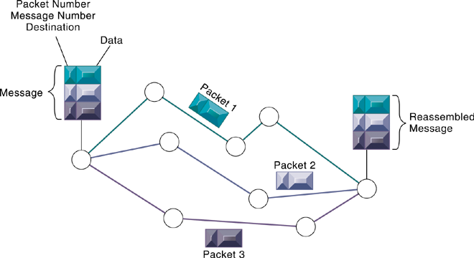
Packet-Switched Networks and Packet Communications
FIGURE 3
Data are grouped into small packets, which are transmitted independently over various communications channels and reassembled at their final destination.
Notes:
This graphic illustrates how packet switching works, showing a message being split into three packets, sent along different routes, and then reassembled at the destination. Note that each packet contains a packet number, message number, and destination.

Slide 15
Telecommunications and Networking in Today’s Business World
Key digital networking technologies (cont.)
  TCP/IP and connectivity
    Protocols: rules that govern transmission of information between two points
    Transmission Control Protocol/Internet Protocol (TCP/IP)
      Common worldwide standard that is basis for Internet
    Department of Defense reference model for TCP/IP
      Four layers
        Application layer
        Transport layer
        Internet layer
        Network interface layer
Notes:
This slide continues the discussion of the three main networking technologies in use today, and looks at the third TCP/IP. Note that in a network, there are typically many different types of hardware and software components that need to work together to transmit and receive information. Different components in a network communicate with one another only by adhering to a common set of rules called protocols. In the past, many diverse proprietary and incompatible protocols often forced business firms to purchase computing and communications equipment from a single vendor. But today, corporate networks are increasingly using a single, common, worldwide standard called Transmission Control Protocol/
Internet Protocol (TCP/IP). TCP/IP actually is a suite of protocols, the main ones of which are TCP and IP. Ask students what these two main protocols are responsible for.

Slide 16
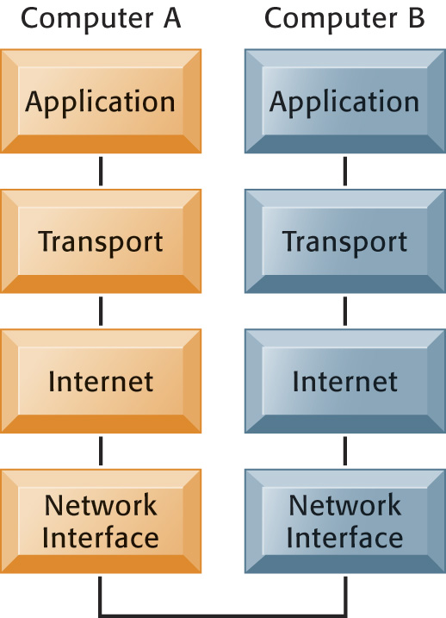
The Transmission Control Protocol/Internet Protocol (TCP/IP) Reference Model (‘70s)
This figure illustrates the four layers of the TCP/IP reference model for communications.
FIGURE 4
Notes:
This graphic illustrates the four layers of the DOD reference model for TCP/IP. Note that what happens, when computer A sends a message to computer B, is that the data that computer A creates is transferred within that computer from the application layer to subsequent layers in sequence. In this process it is split into packets, and information is added at each stage, ultimately translating the packets into a form that can be transferred over the network interface. After traveling over the network interface, the packets are reassembled at the recipient computer, from the network interface layer up, ultimately for use by the application layer.

Slide 17
TCP/IP Reference Model
FIGURE 5
Layer | Protocol
Application | DNS, TFTP, TLS/SSL, FTP, Gopher, HTTP, IMAP, IRC, NNTP, POP3, SIP, SMTP, SMPP, SNMP, SSH, Telnet, Echo, RTP, PNRP, rlogin, ENRP
 | Routing protocols like BGP and RIP which run over TCP/UDP, may also be considered part of the Internet Layer.
Transport | TCP, UDP, DCCP, SCTP, IL, RUDP, RSVP
Internet | IP (IPv4, IPv6), ICMP, IGMP, and ICMPv6
 | OSPF for IPv4 was initially considered IP layer protocol since it runs per IP-subnet, but has been placed on the Link since RFC 2740.
Link | ARP, RARP, OSPF (IPv4/IPv6), IS-IS, NDP
Notes:
This graphic illustrates the four layers of the DOD reference model for TCP/IP. Note that what happens, when computer A sends a message to computer B, is that the data that computer A creates is transferred within that computer from the application layer to subsequent layers in sequence. In this process it is split into packets, and information is added at each stage, ultimately translating the packets into a form that can be transferred over the network interface. After traveling over the network interface, the packets are reassembled at the recipient computer, from the network interface layer up, ultimately for use by the application layer.

Slide 18
The OSI Reference Model
FIGURE 6
OSI Model
 | Data unit | Layer | Function
Host layers | Data | 7. Application | Network process to application
 |  | 6. Presentation | Data representation, encryption and decryption
 |  | 5. Session | Interhost communication
 | Segments | 4. Transport | End-to-end connections and reliability, Flow control
Media layers | Packet | 3. Network | Path determination and logical addressing
 | Frame | 2. Data Link | Physical addressing
 | Bit | 1. Physical | Media, signal and binary transmission
Notes:
This graphic illustrates the four layers of the DOD reference model for TCP/IP. Note that what happens, when computer A sends a message to computer B, is that the data that computer A creates is transferred within that computer from the application layer to subsequent layers in sequence. In this process it is split into packets, and information is added at each stage, ultimately translating the packets into a form that can be transferred over the network interface. After traveling over the network interface, the packets are reassembled at the recipient computer, from the network interface layer up, ultimately for use by the application layer.

Slide 19

TCP/IP Reference Model vs OSI (1947) Reference Model
FIGURE 7
OSI | TCP/IP
Application Layer | Application Layer TELNET, FTP, SMTP, POP3, SNMP, NNTP, DNS,NIS, NFS, HTTP, ...
Presentation Layer
Session Layer
Transport Layer | Transport Layer TCP , UDP , ...
Network Layer | Internet Layer IP , ICMP, ARP, RARP, ...
Data Link Layer | Link Layer FDDI, Ethernet, ISDN, X.25,...
Physical Layer
Notes:
This graphic illustrates the four layers of the DOD reference model for TCP/IP. Note that what happens, when computer A sends a message to computer B, is that the data that computer A creates is transferred within that computer from the application layer to subsequent layers in sequence. In this process it is split into packets, and information is added at each stage, ultimately translating the packets into a form that can be transferred over the network interface. After traveling over the network interface, the packets are reassembled at the recipient computer, from the network interface layer up, ultimately for use by the application layer.

Slide 20
Communications Networks
Signals: Digital versus analog
  Modem: translates digital signals into analog form (and vica versa)
Types of networks
  Local-area networks (LANs)
    Ethernet
    Client/server vs. peer-to-peer
  Wide-area networks (WANs)
  Metropolitan-area networks (MANs)
  Campus area networks (CANs)
Notes:
This slide looks at the types of networks that organizations use. Ask students what the differences are between digital and analog signals. Ask students to describe and distinguish between LANs, CANs, WANs, and MANs, and also to talk about their different range of operation. Note that a network can be defined by the way the clients interact (client/server versus peer-to-peer); the type of physical medium to carry signals (Ethernet, Fast Ethernet, etc.), and the way in which computers are connected and send signals to each other (topology).

Slide 21

Functions of the Modem
FIGURE 8
A modem is a device that translates digital signals into analog form (and vice versa) so that computers can transmit data over analog networks such as telephone and cable networks.
Notes:
This graphic illustrates the differences between digital and analog signals, and shows how digital signals can be sent to other computers over analog cables such as telephone and cable lines which are analog. Note that digital signals are representations of the two binary digits, 0 and 1, and are represented logically as on and off electrical pulses (in reality as different voltages). Ask students what MODEM stands for.

Slide 22
Communications Networks
Physical transmission media
  Twisted pair wire (CAT5)
  Coaxial cable
  Fiber optics cable
  Wireless transmission media and devices
    Satellites
    Cellular systems
Transmission speed
  Bits per second (bps)
  Hertz
  Bandwidth
Notes:
This slide looks at the media involved in network transmission. Note that many of the telephone systems in buildings had twisted wires installed for analog communication, but they can be used for digital communication as well. Also, today, telecommunications companies are starting to bring fiber optic cable into the home for high-speed Internet access.
Note that the transmission capacity of a medium (bps) is dependent on its frequency, which is measured in hertz, or cycles per second. Ask students to define bandwidth (it is the difference between the highest and lowest frequencies that can be accommodated on a single channel.)

Slide 23
The Global Internet
The Internet
  World’s most extensive network
  Internet service providers (ISPs)
    Provide connections
    Types of Internet connections
      Dial-up: 56.6 Kbps
      Digital subscriber line (DSL): 385 Kbps–40 Mbps
      Cable Internet connections: 1–50 Mbps
      Satellite
      T1/T3 lines: 1.54–45 Mbps
Notes:
This slide examines what the Internet is—ask students to describe it and what they use it for. The text refers to the Internet as the most extensive public communication system and the world’s largest implementation of client/server computing.
Ask students how they connect to the Internet. Do any of their families use dial-up (telephone/modem)? Do any use satellite? Note that T lines are leased, dedicated lines suitable for businesses or government agencies requiring high-speed guaranteed service levels. Do students know that the Internet does not guarantee any service level, and agrees only to make a “best effort.”
Ask students what an IP address is used for. Ask students why we have a domain name system, and why we don’t just use IP addresses. Note that the domain name system makes it possible for people to remember addresses.

Slide 24
The Global Internet
Internet addressing and architecture
  IP addresses
The Domain name system (DNS)
  Converts IP addresses to domain names
  Hierarchical structure
  Top-level domains
Internet architecture and governance
  No formal management: IAB, ICANN, W3C
  The future Internet: IPv6 and Internet2
Notes:
Ask students what an IP address is used for. Ask students why we have a domain name system, and why we don’t just use IP addresses. Note that the domain name system makes it possible for people to remember addresses.

Slide 25
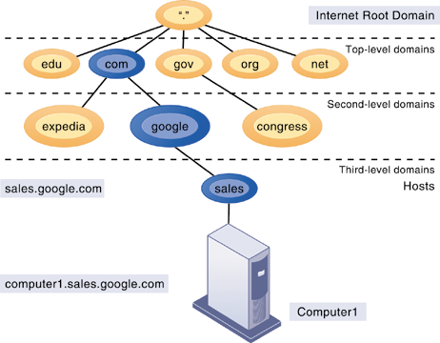
The Domain Name System
The Domain Name System is a hierarchical system with a root domain, top-level domains, second-level domains, and host computers at the third level.
FIGURE 9
Notes:
This graphic describes how the domain name system works. Note that the “root” domain is the period that is used before the top-level domain, such as .edu or .com. Give students an example Internet address, such as myserver.myspace.com and ask them what the top-, second-, and third-level domains are.

Slide 26
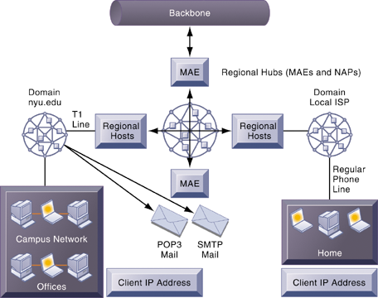
Internet Network Architecture
The Internet backbone connects to regional networks, which in turn provide access to Internet service providers, large firms, and government institutions. Network access points (NAPs) and metropolitan area exchanges (MAEs) are hubs where the backbone intersects regional and local networks and where backbone owners connect with one another.
FIGURE 10
Notes:
This graphic illustrates the architecture of the Internet. Note that MAEs (metropolitan area exchanges) are hubs where the backbone intersects regional and local networks and where backbone networks connect with one another.

Slide 27
The Global Internet
Internet services
  E-mail
  Chatting and instant messaging
  Electronic discussion groups / newsgroups
  Telnet
  File Transfer Protocol (FTP)
  World Wide Web
Notes:
This slide continues the discussion about what the Internet is, here looking at the services, or applications, that the Internet supports. Notice that the Internet comprises many more services than just e-mail and the Web. Ask students which of these services, beyond e-mail and the World Wide Web have they used, and if they have, to describe how it works.

Slide 28
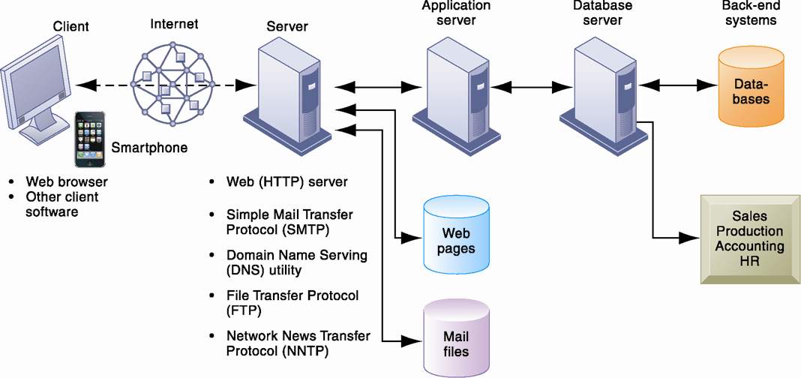
Client/Server Computing on the Internet
FIGURE 11
Client computers running Web browser and other software can access an array of services on servers over the Internet. These services may all run on a single server or on multiple specialized servers.
Notes:
This graphic looks at the services that an Internet server computer can offer: Web sites (HTTP), e-mail (SMTP), file transfer (FTP), newsgroups (NNTP). It illustrates where on the path between client and backend systems these services lie.

Slide 29
The Global Internet
  Voice over IP (VoIP)
    Digital voice communication using IP, packet switching
    Providers
      Cable providers
      Google, Skype
  Unified communications
    Communications systems that integrate voice, data, e-mail, conferencing
  Virtual private network (VPN)
    Secure, encrypted, private network run over Internet
      PPTP
      Tunneling
Notes:
Students who have cable Internet telephones are using VoIP. Other popular technologies that use the Internet as a platform are VoIP, unified communications, and virtual private networks. Ask students what they think is the value to business is of each of these technologies.

Slide 30
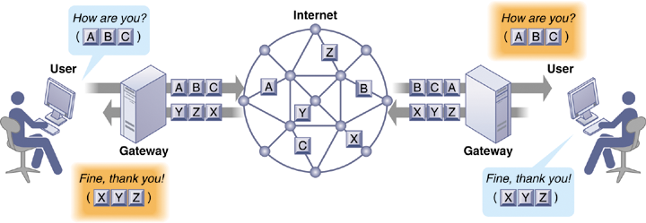
How Voice over IP Works
FIGURE 12
A VoIP phone call digitizes and breaks up a voice message into data packets that may travel along different routes before being reassembled at the final destination. A processor nearest the call’s destination, called a gateway, arranges the packets in the proper order and directs them to the telephone number of the receiver or the IP address of the receiving computer.
Notes:
This graphic shows how VoIP works. The voice messages are digitized and transported over the Internet in the same packet-switching method as traditional Internet data. Gateways are simply computers (network devices) that maintain the interface with the Internet in a firm.

Slide 31
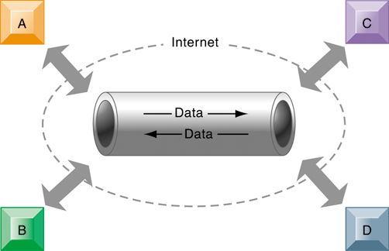
A Virtual Private Network Using the Internet
FIGURE 13
This VPN is a private network of computers linked using a secure “tunnel” connection over the Internet. It protects data transmitted over the public Internet by encoding the data and “wrapping” them within the Internet Protocol (IP). By adding a wrapper around a network message to hide its content, organizations can create a private connection that travels through the public Internet.
Notes:
This graphic illustrates how a virtual private network works. The rectangles A, B, C, and D represent different computers on the VPN. In a process
called tunneling, packets of data are encrypted and wrapped inside IP packets. By adding this wrapper around a network message to hide its content, business firms create a private connection that travels through the public Internet.

Slide 32
The Global Internet
The Web
  Hypertext Markup Language (HTML)
  Hypertext Transfer Protocol (HTTP):
    Communications standard used for transferring Web pages
  Uniform resource locators (URLs):
    Addresses of Web pages
      http://www.megacorp.com/content/features/082602.html
  Web servers
      Software for locating and managing Web pages
Notes:
This slide looks at one of the most popular services on the Internet, the Web, and the main protocols enabling the Web. The Web is an interlinked connection of Web sites, which are collections of Web pages linked to a home page. These pages are created using a text markup language call HTML, and transmitted to user’s Web browsers by HTTP. Web page addresses (URLs) are composed of the domain name of the Web site and the file location of the individual Web page. Ask students if any have created Web pages using HTML, and if so, to describe what this is like. How have they made the Web pages visible to others on the Web? There is a learning track available online that shows students how to create Web pages using basic HTML.

Slide 33
The Global Internet
Search engines
  Started as simpler programs using keyword indexes
  Google improved indexing and created page ranking system
Mobile search: 20% of all searches in 2012
Search engine marketing
  Major source of Internet advertising revenue
Search engine optimization (SEO)
  Adjusting Web site and traffic to improve rankings in search engine results
Notes:
This slide looks at how people find information of interest on the Web. The primary method is through search engines, which today act as major portals to the Web. Ask students where their initial points of entry are on the Web, and how they find information they are interested in. Most will be Google users, but ask if they have looked at Bing, the Microsoft search engine that is showing some promise.
The text discusses how big the Web is, in terms of pages. Google visited and indexed the content of more than an estimated 50 billion Web pages in 2011, but this does not include the “deep Web.” Other estimates point to “one trillion” Web pages, but many of these are duplicates.

Slide 34
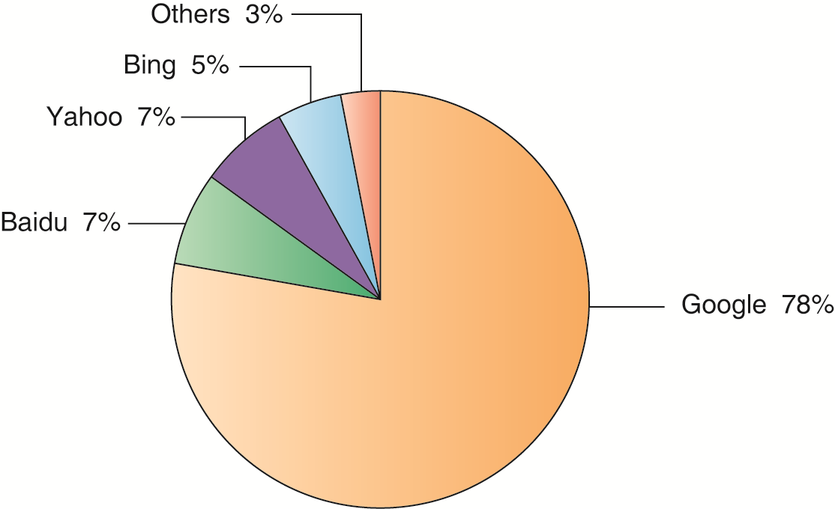
Top U.S. Web Search Engines
Google is the most popular search engine on the Web, handling 84 percent of all Web searches.
FIGURE 14
Notes:
This graphic ranks the major search engines according to popularity, or percentage of total number of searches performed. Google is a clear favorite. Is this due to the superiority of their search engine results or does it involve other factors such as their clean interface, or their reach, which makes their ad platform more valuable to advertisers. Poll your class about the search engines they use. Baidu is the popular Chinese language search engine.

Slide 35
The Global Internet
Social search
  Google +1, Facebook Like
Semantic search
  Anticipating what users are looking for rather than simply returning millions of links
Intelligent agent shopping bots
  Use intelligent agent software to search Internet for shopping information
Notes:
Ask students what the “deep Web” is. Note that Web pages available only to subscribers for a fee (“premium content”) do not allow crawlers to index the pages. Shopping bots are always fun to visit in class. Ask students what they might be interested in having you shop for, and then use one of the shop bots like Shopzilla or Pricegrabber.

Slide 36
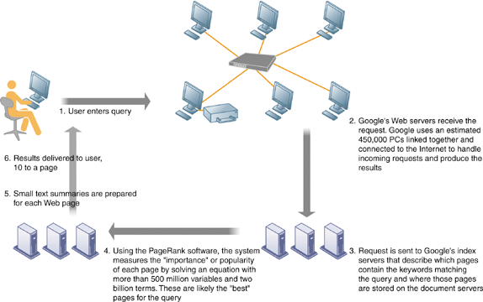
How Google Works
FIGURE 15
The Google search engine is continuously crawling the Web, indexing the content of each page, calculating its popularity, and storing the pages so that it can respond quickly to user requests to see a page. The entire process takes about one-half second.
Notes:
This graphic illustrates in a very high level diagram how Google works. At the foundation of Google’s search engine are two concepts—page ranking and the indexing of combinations of words. Ask students if they have a favorite search engine, and if so, why that search is their favorite. The reality of how Google actually works is the subject of many volumes, and is beyond the scope of this book.

Slide 37
Global Internet
IPv6
  IP addresses
Web 2.0
  Trend in Web technology and design that aims to enhance creativity, information sharing, and, especially, collaboration among users.
Web 3.0 - ‘Semantic Web’
  Intelligent interaction among systems and applications on the Web by deploying ontologies, semantic annotation of Web content, and reasoning.
  Ultimate goal is to make data understandable to computers, and thus open to far greater utility and manipulation.
Notes:
Ask students what an IP address is used for. Ask students why we have a domain name system, and why we don’t just use IP addresses. Note that the domain name system makes it possible for people to remember addresses.

Slide 38
The Global Internet
Web 2.0
  Second-generation services
  Enabling collaboration, sharing information, and creating new services online
  Features
    Interactivity
    Real-time user control
    Social participation (sharing)
    User-generated content
Notes:
This slide discusses the features of Web 2.0 services to answer the question, what makes a Web site “Web 2.0” rather than a traditional, or 1.0 site?

Slide 39
The Global Internet
  Web 2.0 services and tools
    Blogs: chronological, informal Web sites created by individuals
      RSS (Really Simple Syndication): syndicates Web content so aggregator software can pull content for use in another setting or viewing later
      Blogosphere
      Microblogging
    Wikis: collaborative Web sites where visitors can add, delete, or modify content on the site
    Social networking sites: enable users to build communities of friends and share information
Notes:
This slide describes examples of Web 2.0 services. Ask if students use a blog reader, such as Google Reader, to read their blogs. If they have, they have used RSS to pull in the content from their blogs to read them in one place. Note that wikis are used in business to share information. Note that Twitter is one form of microblogging. Another example is Tumblr.

Slide 40
The Global Internet
Web 3.0: The “Semantic Web”
  A collaborative effort led by W3C to add layer of meaning to the existing Web
  Goal is to reduce human effort in searching for and processing information
  Making Web more “intelligent” and intuitive
  Increased communication and synchronization with computing devices, communities
  “Web of things”
  Increased cloud computing, mobile computing
Notes:
The Web of things includes the idea that our cars, refrigerators, heaters and air conditioning units, along with all other appliances, and buildings, will be on the Internet.

Slide 41
The Wireless Revolution
Cellular systems
  Competing standards
    CDMA: United States only
    GSM: Rest of world, AT&T, T-Mobile
  Third-generation (3G) networks
    144 Kbps
    Suitable for e-mail access, Web browsing
  Fourth-generation (4G) networks
    Up to 100 Mbps
    Suitable for Internet video
Notes:
This slide discusses the continuing revolution in wireless communication. Ask students what changes or improvements have happened in their cell phone service over the past two years. Have they purchased or upgraded a cell phone in that time, and if so, why? Most cell phone users today rely on 3G networks, a standard which first appeared in the early 2000s, and was improved upon over the last decade. 3G networks have mobile upload capacities of about 144 mbps, enough for email and some Web browsing, but not videos. 4G networks started appearing in 2010 in the United States. They are also called LTE (Long Term Evolution) networks. 4G cell networks can be used for display of video on mobile devices with download speeds of about 100 mbps, and upload speeds of 50 mbps. How many students watch videos on their smartphones?

Slide 42
The Wireless Revolution
Wireless computer networks and Internet access
  Bluetooth (802.15)
    Links up to 8 devices in 10-m area using low-power, radio-based communication
    Useful for personal networking (PANs)
  Wi-Fi (802.11)
    Set of standards: 802.11
    Used for wireless LAN and wireless Internet access
    Use access points: device with radio receiver/transmitter for connecting wireless devices to a wired LAN
Notes:
This slide discusses the current standards in wireless networking. Ask students if they have any Bluetooth or wireless devices they use for computing, such as keyboards, earphones, or other. Note that in most Wi-Fi communications, wireless devices communicate with a wired LAN using an access point.

Slide 43
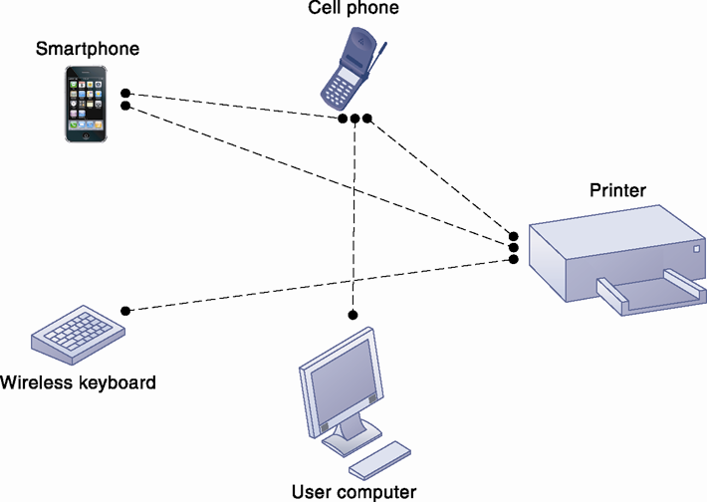
A Bluetooth Network (PAN)
Bluetooth enables a variety of devices, including cell phones, PDAs, wireless keyboards and mice, PCs, and printers, to interact wirelessly with each other within a small 30-foot (10-meter) area. In addition to the links shown, Bluetooth can be used to network similar devices to send data from one PC to another, for example.
FIGURE 16
Notes:
This graphic illustrates the uses of Bluetooth for a PAN. Bluetooth connects wireless keyboards and mice to PCs or cell phones to earpieces without wires. Bluetooth has low-power requirements, making it appropriate for battery-powered handheld computers, and cell phones. Most cell phones today are Bluetooth enabled, allowing them to connect to other wireless devices (like earphones) and PCs.

Slide 44
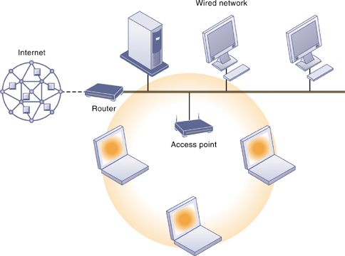
An 802.11 Wireless LAN
Mobile laptop computers equipped with wireless network interface cards link to the wired LAN by communicating with the access point. The access point uses radio waves to transmit network signals from the wired network to the client adapters, which convert them into data that the mobile device can understand. The client adapter then transmits the data from the mobile device back to the access point, which forward the data to the wired network.
FIGURE 17
Notes:
This graphic illustrates an 802.11 wireless LAN operating in infrastructure mode that connects a small number of mobile devices to a larger wired LAN. Most wireless devices are client machines. The servers that the mobile client stations need to use are on the wired LAN. The access point controls the wireless stations and acts as a bridge between the main wired LAN and the wireless LAN. (A bridge connects two LANs based on different technologies like your wireless network to your BlueRay player so you can download Internet movies from Netflix and watch them on your TV). The access point also controls the wireless stations.

Slide 45
The Wireless Revolution
Wireless computer networks and Internet access
  Wi-Fi (cont.)
    Hotspots: one or more access points in public place to provide maximum wireless coverage for a specific area
    Weak security features
  WiMax (802.16)
    Wireless access range of 31 miles
    Require WiMax antennas
Notes:
This slide continues the discussion about wireless networking and Wi-Fi. Ask students if they have ever connected to the Internet through a hotspot at an airport, coffee shop, hotel, or other location. Was there any security?
Ask students what other drawbacks, beside security, there are to Wi-Fi (roaming difficulties, interference). Note that wireless networks based on the upcoming 802.11n specification will solve interference problems by using multiple wireless antennas in tandem to transmit and receive data and technology to coordinate multiple simultaneous radio signals. What is this technology called? (MIMO).

Slide 46
The Wireless Revolution
Radio frequency identification (RFID)
  RFID tags:
    Tiny tags with embedded microchips contain data about an item and location
    Transmit radio signals over short distances to RFID readers
  RFID readers:
    Send data over network to computer for processing
  Active RFID:
    Tags have batteries
    Data can be rewritten
    Range is hundreds of feet
Notes:
This slide introduces one of two wireless technologies having a major impact on business, radio frequency ID. Ask students for examples of where RFID is used today. The text provides the example of Walmart using RFID to manage inventory and supply chains. Ask students how this works.

Slide 47
The Wireless Revolution
RFID (cont.)
  Passive RFID:
    Range is shorter
    Smaller, less expensive
    Powered by radio frequency energy
  Common uses:
    Automated toll-collection
    Tracking goods in a supply chain
  Requires companies to have special hardware and software
  Reduction in cost of tags making RFID viable for many firms
Notes:
This slide continues the discussion of RFID technology. Although the cost of RFID tags used to be too costly for widespread implementation, today the cost is about 10 cents for a passive tag, so RFID is becoming more cost-effective.
Ask students why special hardware and software is needed to use RFID. (To filter, aggregate, and prevent RFID data from overloading business networks and system applications.) Also, applications will need to be redesigned to accept massive volumes of frequently generated RFID data and to share those data with other applications. Major enterprise software vendors, including SAP and Oracle-PeopleSoft, now offer RFID-ready versions of their supply chain management applications.

Slide 48
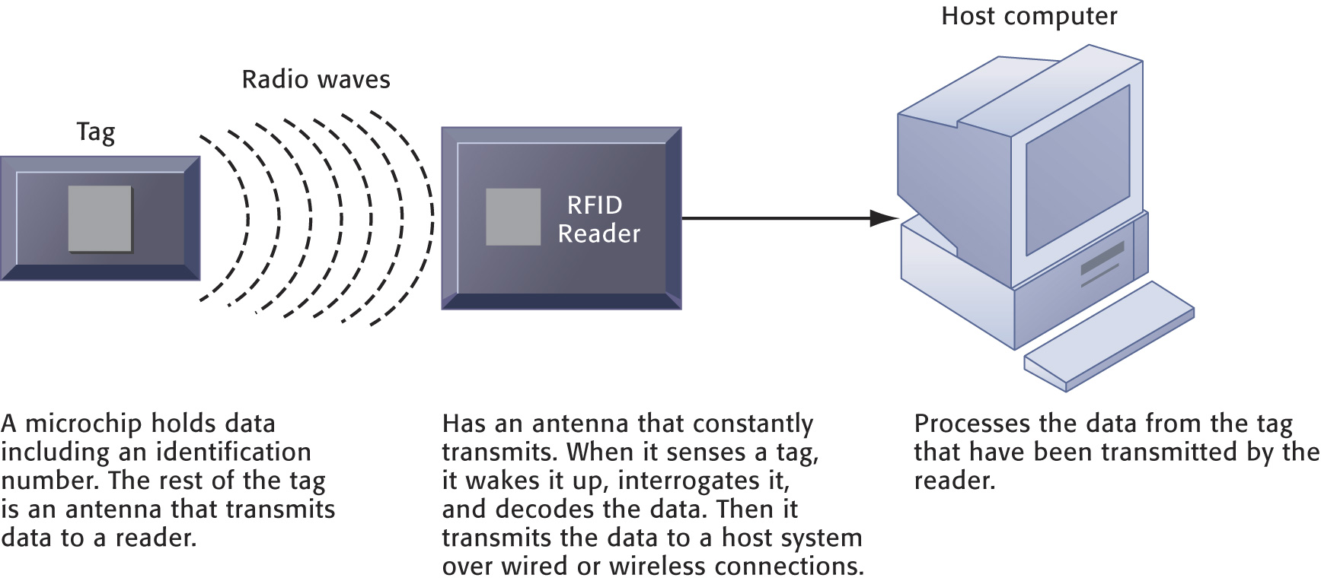
How RFID Works
FIGURE 18
RFID uses low-powered radio transmitters to read data stored in a tag at distances ranging from 1 inch to 100 feet. The reader captures the data from the tag and sends them over a network to a host computer for processing.
Notes:
This graphic illustrates how RFID works. Ask students if RFID potentially poses any ethical problems. For example, if your jeans have a built in RFID chip, it’s easy to track your movements. Likewise if your student ID card has an RFID chip.

Slide 49
The Wireless Revolution
Wireless sensor networks (WSNs)
  Networks of hundreds or thousands of interconnected wireless devices embedded into physical environment to provide measurements of many points over large spaces
  Used to monitor building security, detect hazardous substances in air, monitor environmental changes, traffic, or military activity
  Devices have built-in processing, storage, and radio frequency sensors and antennas
  Require low-power, long-lasting batteries and ability to endure in the field without maintenance
Notes:
This slide introduces a second wireless technology having a major impact on business, wireless sensor networks. Note that the wireless sensors are linked into an interconnected network that routes the data to a computer for analysis.

Slide 50
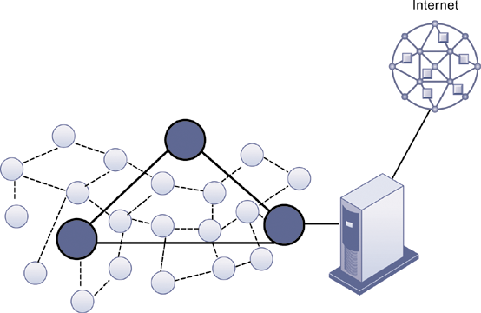
A Wireless Sensor Network
The small circles represent lower-level nodes and the larger circles represent high-end nodes. Lower-level nodes forward data to each other or to higher-level nodes, which transmit data more rapidly and speed up network performance.
FIGURE 19
Notes:
This graphic illustrates the lower level nodes and higher level nodes at work in a wireless sensor network. Note that the server that data from the sensors is sent to acts as a gateway to a network based on Internet technology.

Slide 51
RFID and Wireless Technology Speed Up Production at Continental Tyres
Problem: Inefficient manual processes; large production environment.

Slide 52
RFID and Wireless Technology Speed Up Production at Continental Tyres
Solution: Track components in real time, optimize transportation, and expedite communication
  Wi-Fi networks
  RFID technologies
  Mobile handhelds
  Material inventory tracking software
Demonstrates use of technology in production and supply chain to increase efficiency and lower costs.

Slide 53
Telecommunications, the Internet, and Wireless Technology
VIDEO CASES:
  Case 1: Telepresence Moves Out of the Boardrooom and Into the Field
  http://www.youtube.com/watch?v=rcfNC_x0VvE
  World’s Most Collaborative Company??
  http://www.youtube.com/watch?v=NOyen7wUWZM
  Case 2: Unified Communications Systems: Virtual Collaboration with Lotus Sametime
  http://www.youtube.com/watch?v=qJJWx552lFE
Notes:
There are two video cases and three instructional videos available for this chapter.

Slide 54
Summary
Networking and Communication Trends
    Convergence
    Broadband
    Broadband Wireless
Key digital networking technologies
    Client/Server Computing
    Packet switching
    TCP/IP Connectivity
Communication Networks
The Global Internet
The Wireless Revolution
Notes:
Students may not know exactly what is meant by globalization or may have an incomplete understanding of the term. You might ask students what they think it means. Potential answers could include: reduction of economic and cultural advantages of developed countries, increased number of companies with operations in multiple countries worldwide, and increased reliance on imports and exports of goods (and jobs). Globalization will be discussed in later slides as well.

Slide 55
Next Week……
Securing Information Systems
Achieving Operational Excellence and Customer Intimacy: Enterprise Applications

